Slide 1

Solar Power Plant design

Slide 2



Load in Watts
Load Current $l_{L}$ =
1.732X Voltage in volts X power Factor
3 o Voltage Drop is given by = $v_{d}$
$$\frac{\sqrt{3} x l_{L}x Z x L}{1000}$$

Slide 3
R=RO (1+a (T-20))
Here a is temperature coefficient of resistance for conductor material
a-0.00429 for Aluminium
a=0.00393 for Copper

Slide 4
Criteria to be fulfilled (AC)
Below 6.6 KV
1.Derated current Capacity > Imax
2. Voltage Drop < 5%
3. Power Loss < 2%
Above 6.6 KV
1.Derated current Capacity > Imax
2. Derated Current Capacity > Isc
3. Power Loss < 5%
4. Power Loss < 5%

Slide 5
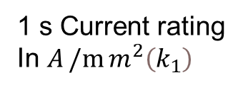
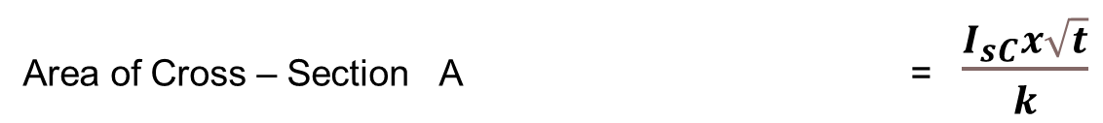
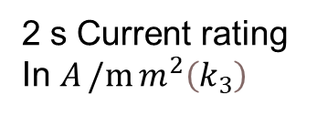
0
Area of Cross – Section A = $\frac{I_{sC}x\sqrt{t}}{k}$
Material Copper Aluminium
Insulation
PVC Butyl Rubber XLPE /EPR
115 134 143
66 77 83
PVC Butyl Rubber XLPE /EPR
76 89 94
44 51 54
1 s Current rating
In $A/m{m^{2}\left(k_{1}\right)}$
2 s Current rating
In $A/m{m^{2}\left(k_{3}\right)}$

Slide 6
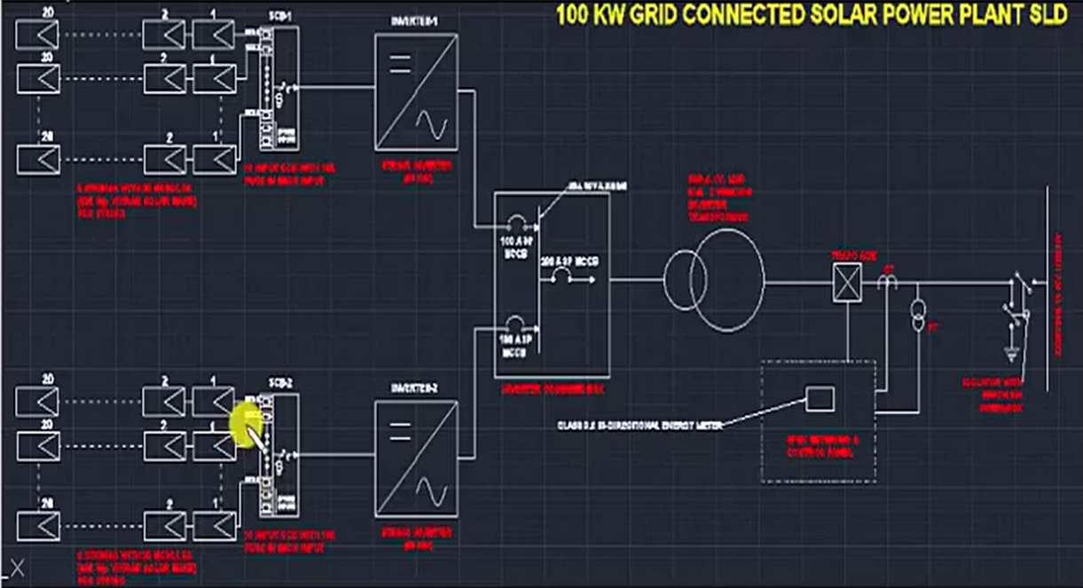

Slide 7
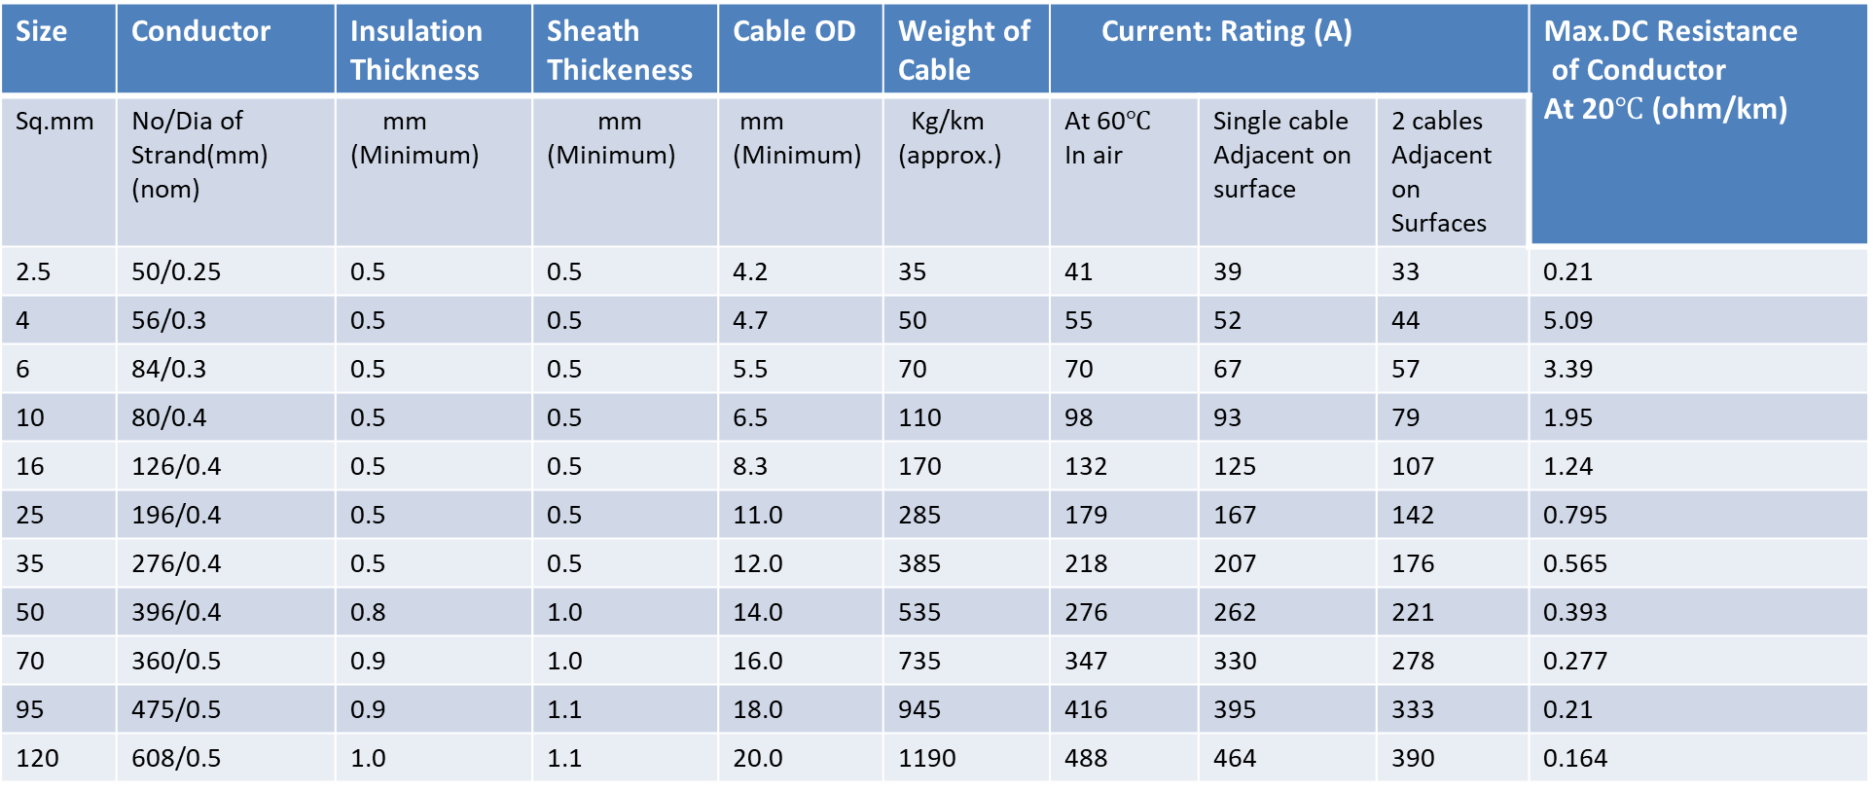
Solar Dc Cables as per standard EN 50618 are also available. “APAR ANUSHAKTI” E-Beam Irradiated atc flexible conductor,Xlpo insulated sheathed solar cable
Size | Conductor | Insulation Thickness | Sheath Thickeness | Cable OD | Weight of Cable | Current: Rating (A) |  |  | Max.DC Resistance of Conductor At 20$℃$ (ohm/km)
Sq.mm | No/Dia of Strand(mm) (nom) | mm (Minimum) | mm (Minimum) | mm (Minimum) | Kg/km (approx.) | At 60$℃$ In air | Single cable Adjacent on surface | 2 cables Adjacent on Surfaces
2.5 | 50/0.25 | 0.5 | 0.5 | 4.2 | 35 | 41 | 39 | 33 | 0.21
4 | 56/0.3 | 0.5 | 0.5 | 4.7 | 50 | 55 | 52 | 44 | 5.09
6 | 84/0.3 | 0.5 | 0.5 | 5.5 | 70 | 70 | 67 | 57 | 3.39
10 | 80/0.4 | 0.5 | 0.5 | 6.5 | 110 | 98 | 93 | 79 | 1.95
16 | 126/0.4 | 0.5 | 0.5 | 8.3 | 170 | 132 | 125 | 107 | 1.24
25 | 196/0.4 | 0.5 | 0.5 | 11.0 | 285 | 179 | 167 | 142 | 0.795
35 | 276/0.4 | 0.5 | 0.5 | 12.0 | 385 | 218 | 207 | 176 | 0.565
50 | 396/0.4 | 0.8 | 1.0 | 14.0 | 535 | 276 | 262 | 221 | 0.393
70 | 360/0.5 | 0.9 | 1.0 | 16.0 | 735 | 347 | 330 | 278 | 0.277
95 | 475/0.5 | 0.9 | 1.1 | 18.0 | 945 | 416 | 395 | 333 | 0.21
120 | 608/0.5 | 1.0 | 1.1 | 20.0 | 1190 | 488 | 464 | 390 | 0.164

Slide 8
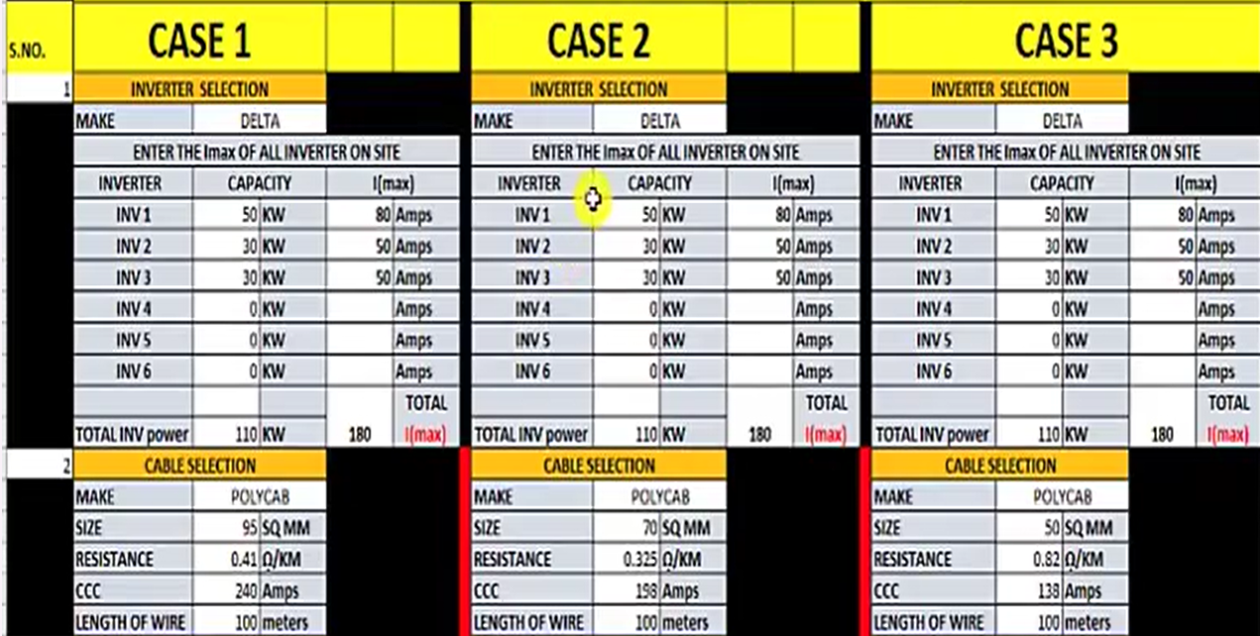
AC Cable ACDB To MDB (Client’s side)

Slide 9
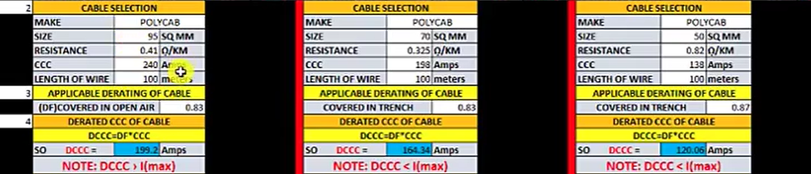

Slide 10

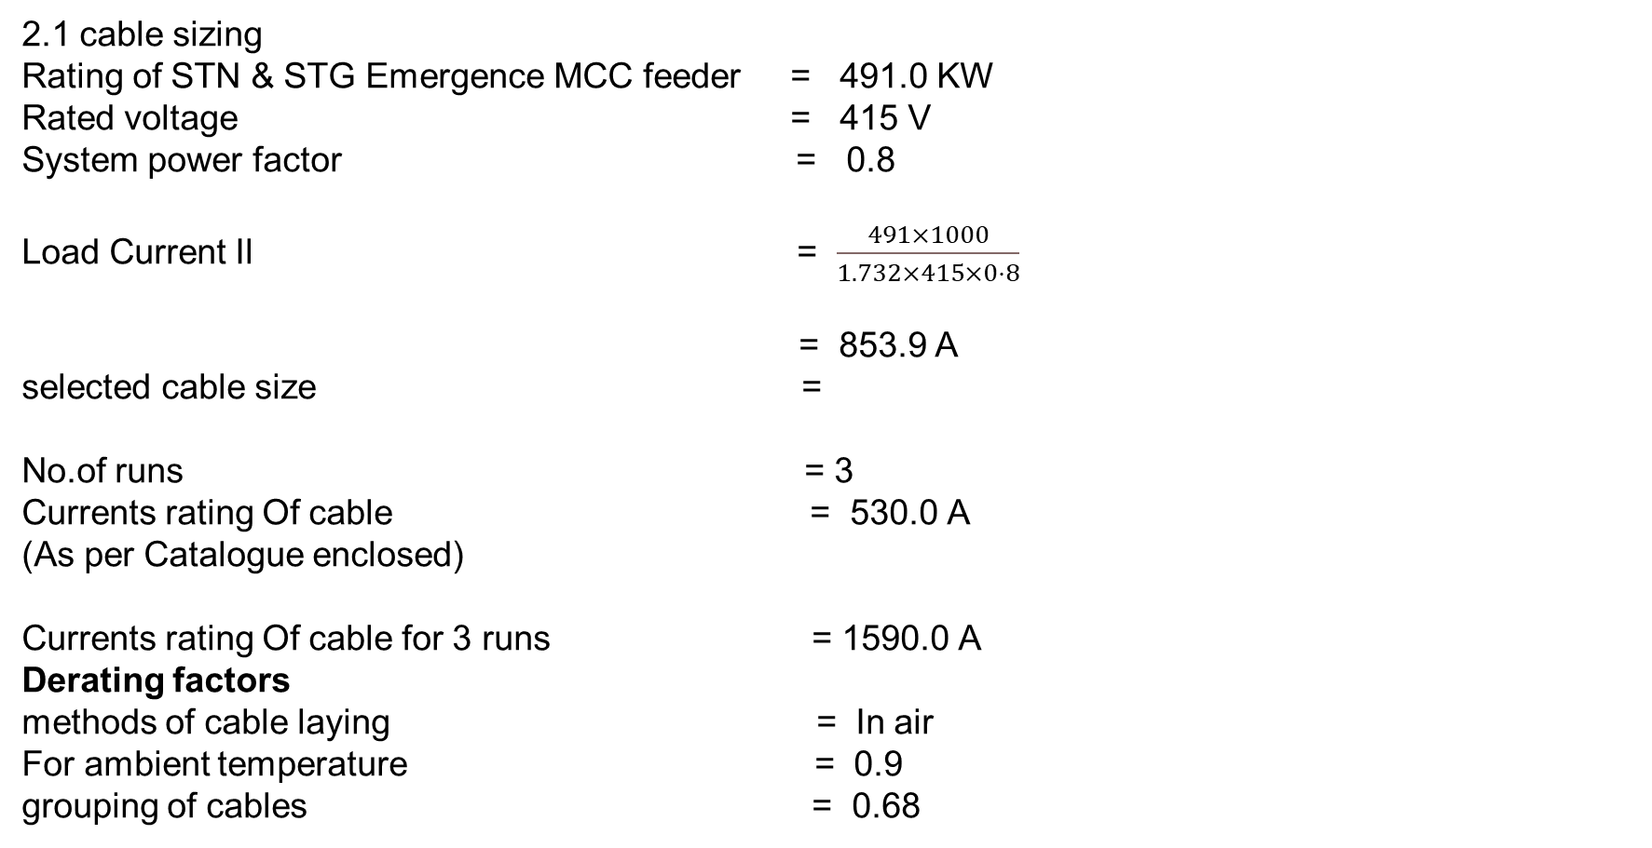
2.1 cable sizing
Rating of STN & STG Emergence MCC feeder = 491.0 KW
Rated voltage = 415 V
System power factor = 0.8
Load Current Il = $\frac{491×1000}{1.732×415×0⋅8}$
= 853.9 A
selected cable size =
No.of runs = 3
Currents rating Of cable = 530.0 A
(As per Catalogue enclosed)
Currents rating Of cable for 3 runs = 1590.0 A
Derating factors
methods of cable laying = In air
For ambient temperature = 0.9
grouping of cables = 0.68

Slide 11
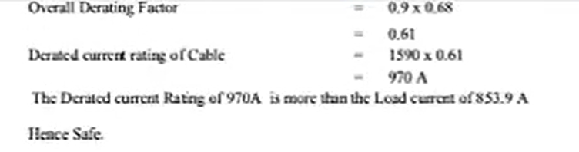

Slide 12
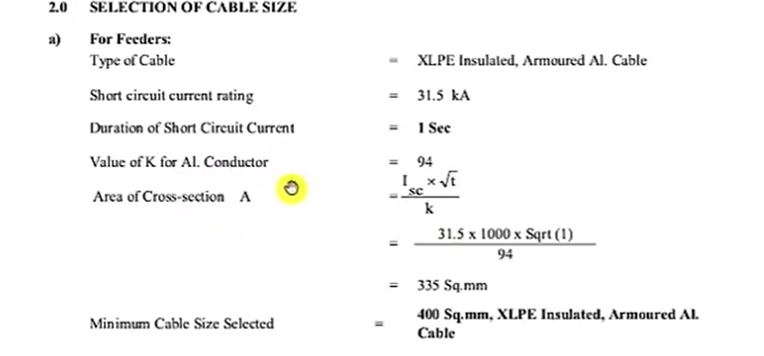

Slide 13
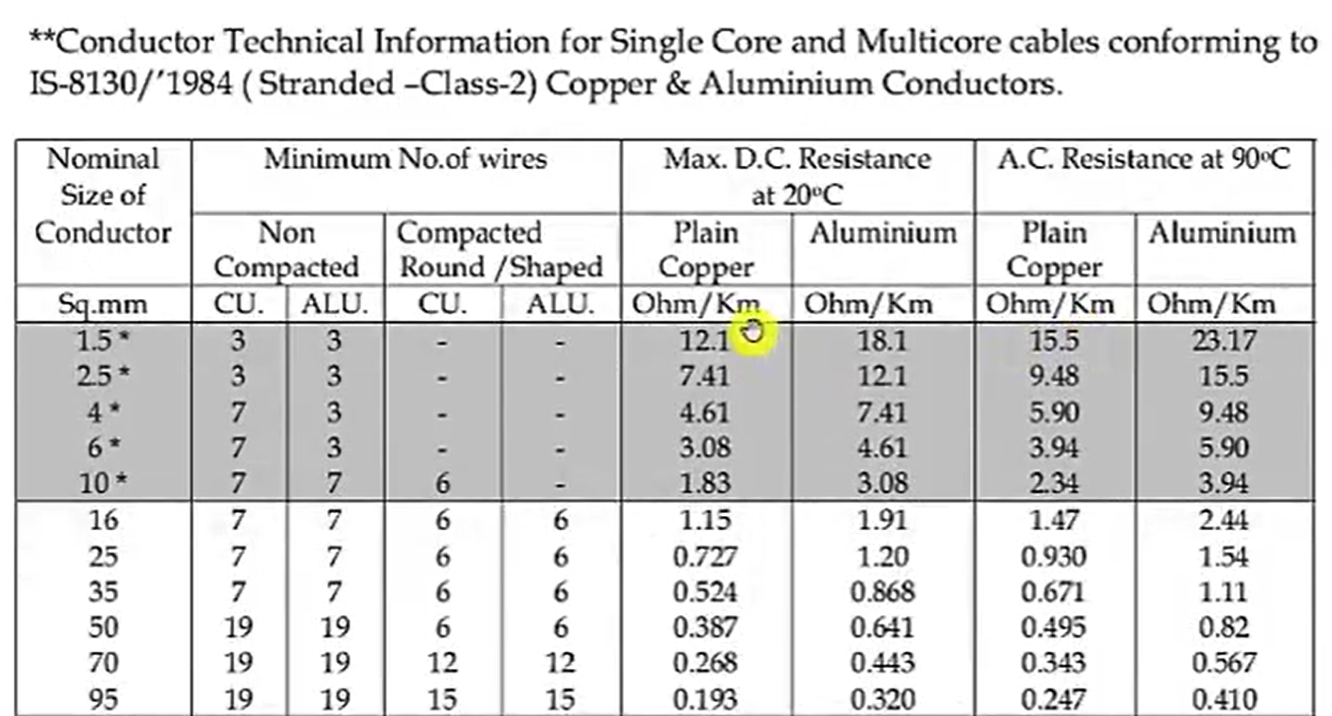

Slide 14
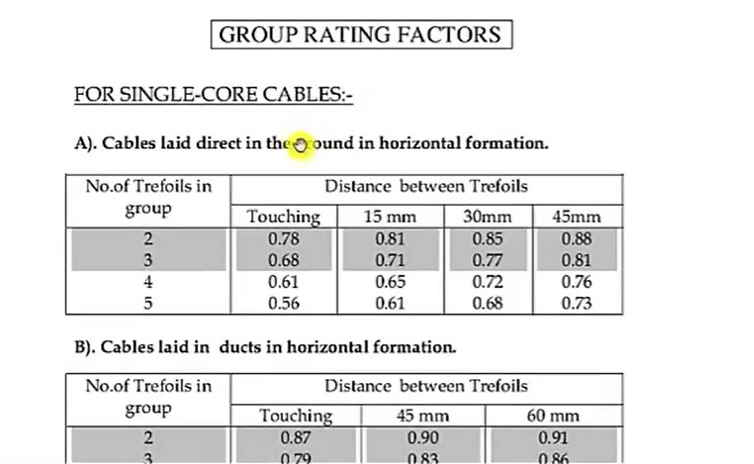

Slide 15
Thank You

